Slide 1
Code Organization and Reproducible Workflows
UBC Bioinformatics and Statistics Workshop
Session 5
Josh Dyce
December 3, 2025

Slide 2
Learning Objectives
Understand the importance of writing reproducible code
Be able to design a well organized project structure with clear folder and file names
Be able to write and document reusable code

Slide 3
Today’s Format
Lecture
  Importance of code organization
  Functions and function documentation
  Organizing the project directory
  Advanced workflow management (briefly)
Hands-on example
  Fixing a workflow made with bad coding practice

Slide 4

Why is having clean code important?
Reproducibility is the number one goal
  Others should be able to run you analyses and get the same results
What if you want to make changes to you analysis?
Clean, organized code allows for easier understanding and debugging
Notes:
Good code is easy to adapt

Slide 5
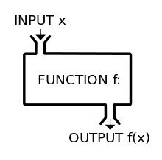
How can functions help you write cleaner code?
Functions promote modular design
  Complex analysis broken into manageable steps
  This makes debugging easier
Functions reduce code repetition and improve readability
Ideally, a function should only perform 1 task
  I.e., generating a figure

Slide 6
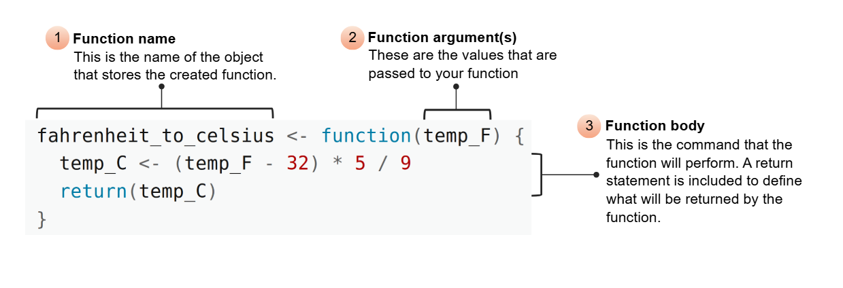
The anatomy of a function
Image source: https://swcarpentry.github.io/r-novice-inflammation/02-func-R.html

Slide 7
Roxygen2 style documentation
What does the
function do?
#' Take two numeric inputs and
#' return their sum.
#'
#' @param x A numeric value.
#' @param y A numeric value.
#'
#' @return The sum of `x` and `y`.
add_numbers <- function(x, y) {
x + y
}
What are the inputs?
What is the output?

Slide 8
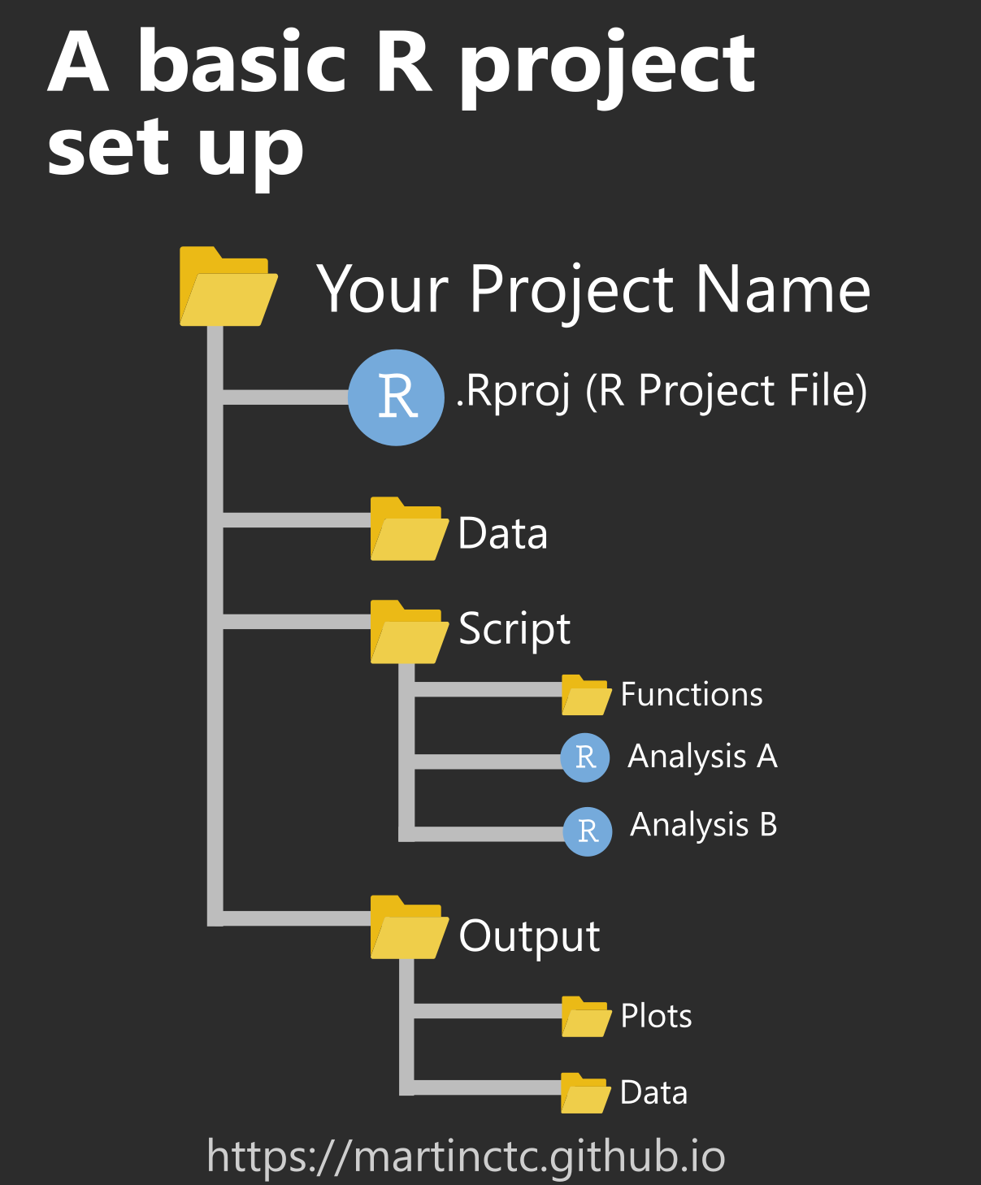
How do you decide on a project folder structure?
Having an organized project structure makes it easier to understand
There is no ‘right’ answers
  Specific structure may depend on the analysis
  Some tools require certain structures
Modifying scripts to save output in an organized way can be helpful

Slide 9


Advanced workflow management
Workflow managers like nextflow can help with:
  Parallelization
  Checkpointing
  And much more….
Containers like Docker or Apptainer ensure consistent environments
These technologies are helpful, but can be hard to learn!

Slide 10
Hands-On Example

